Slide 1



VAE, GANs, and Pokemons

Slide 2

Team
Jiayi Shen
Xiaoyu Yang
Yaoyuan Gan

Slide 3



Problem Statement
Pokemons are fun
We want more Pokemons
Maybe GANs can help us to do so

Slide 4
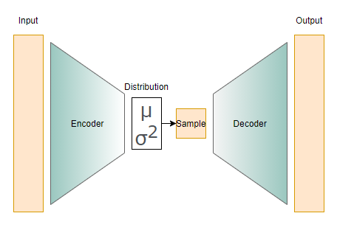

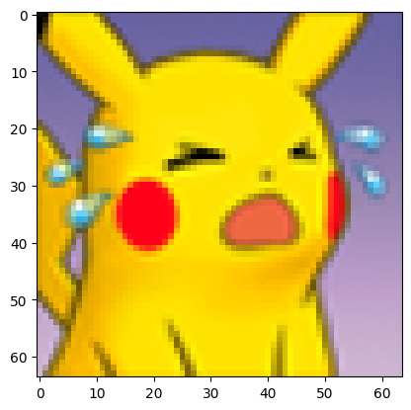
Step 1 - VAE(Variational Autoencoder)

Slide 5
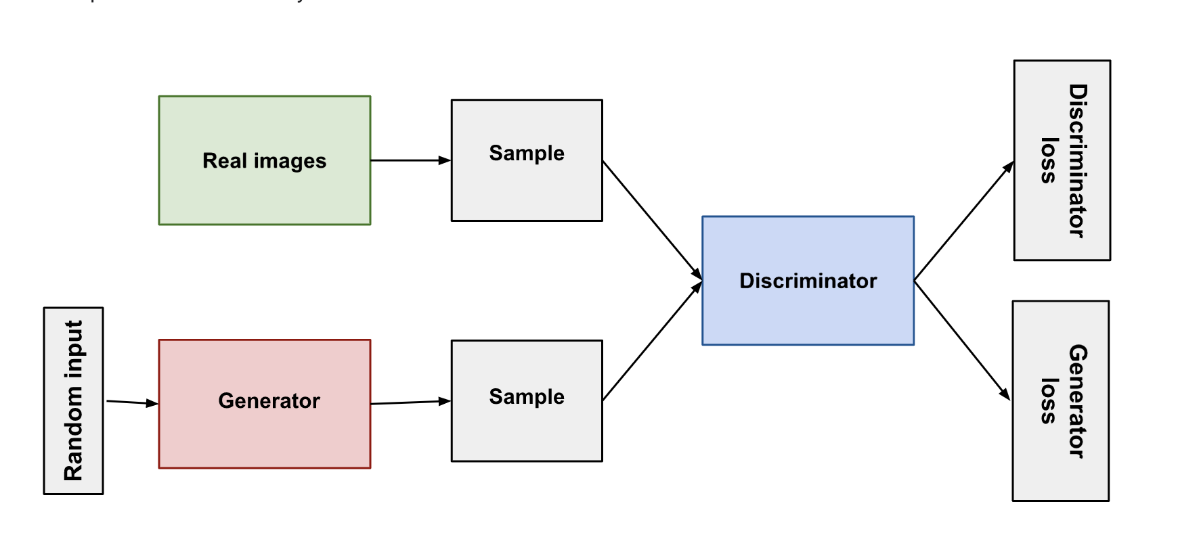


Step 2 - GAN(Generative Adversarial Network)

Slide 6
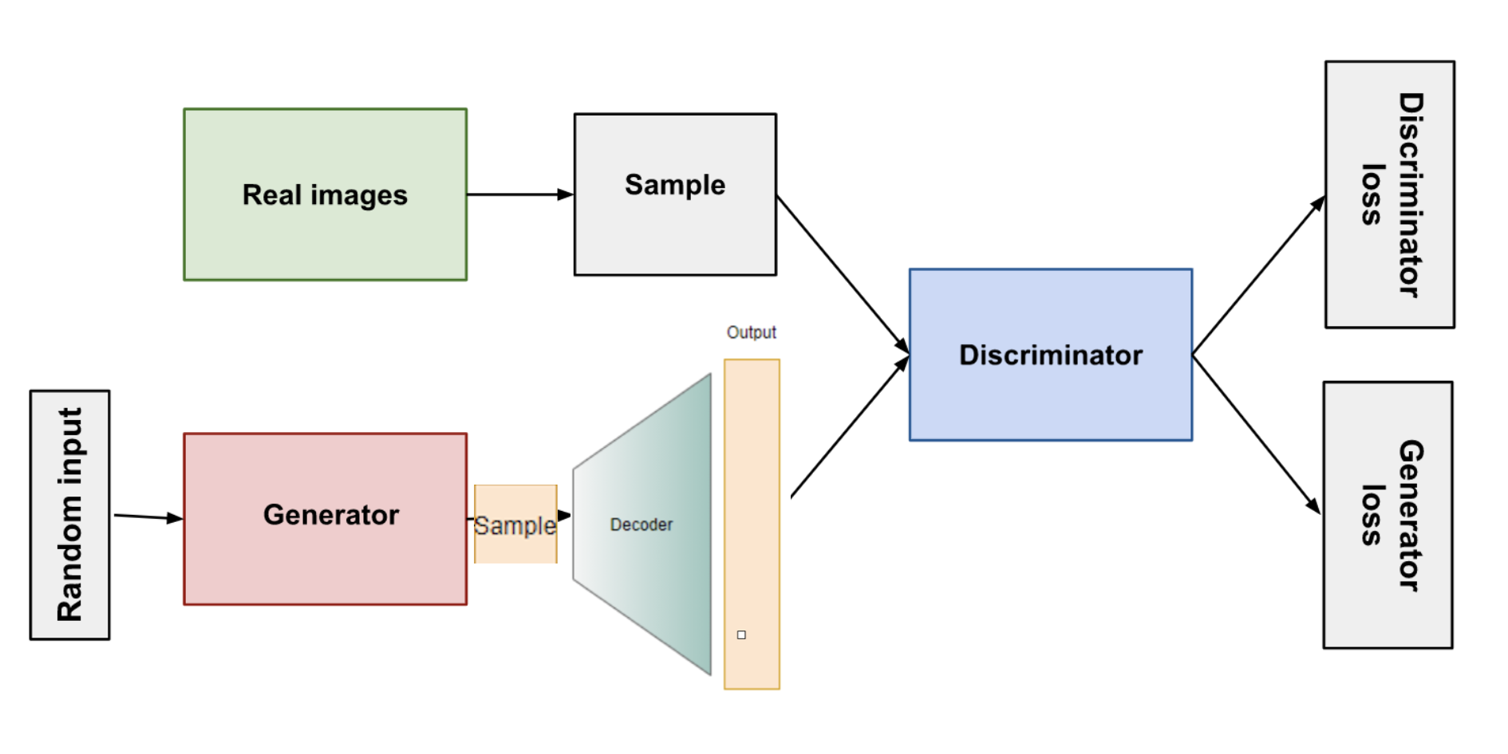


Step 3 -
Embed the Decoder from VAE into GAN

Slide 7
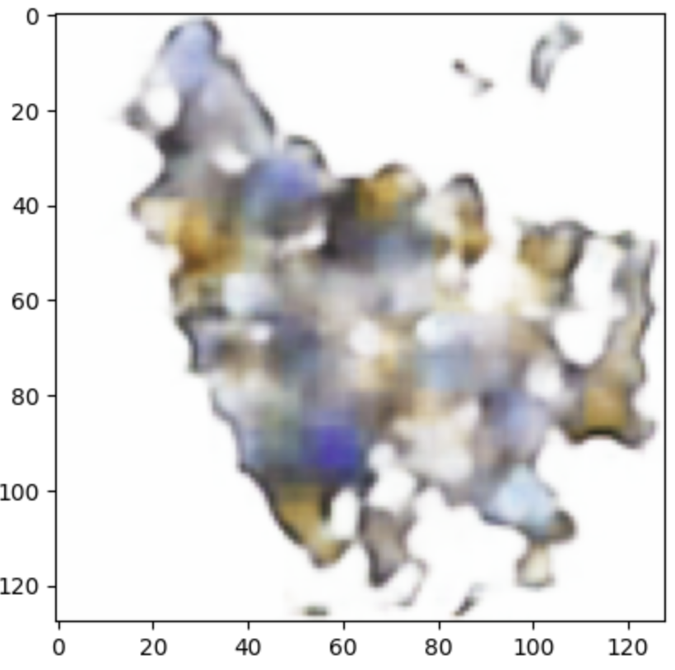
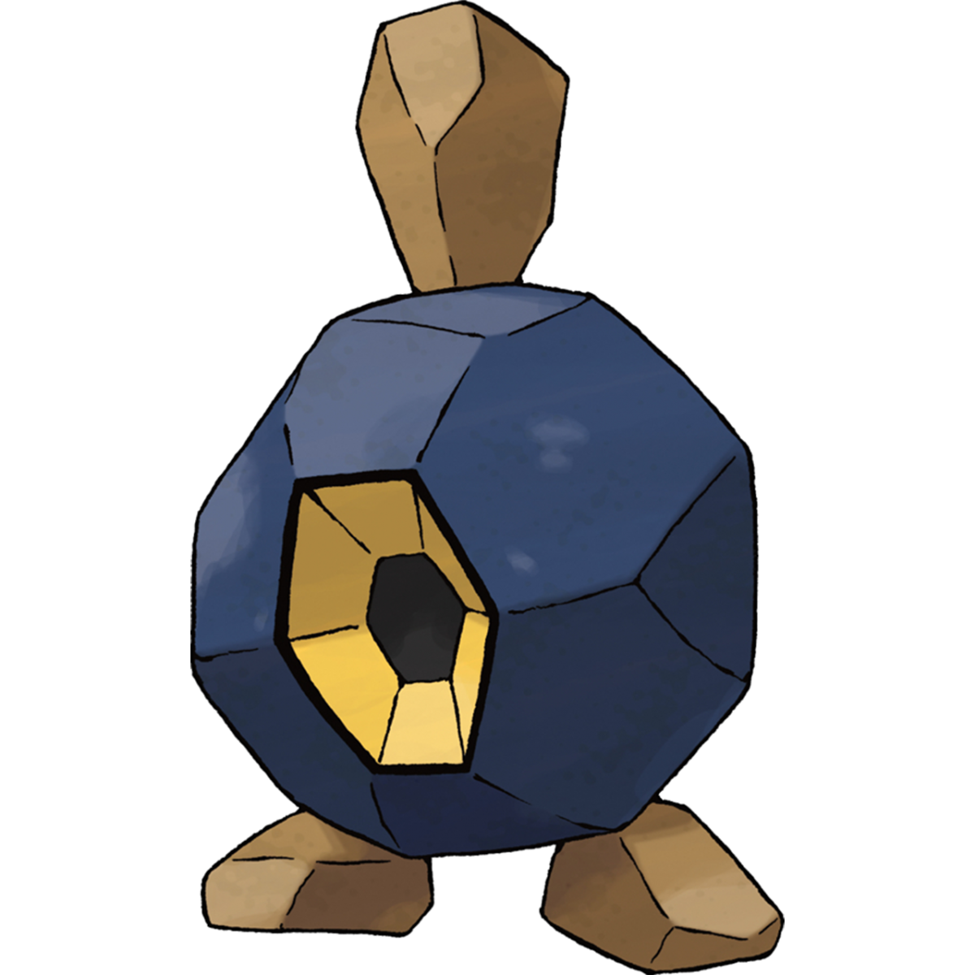
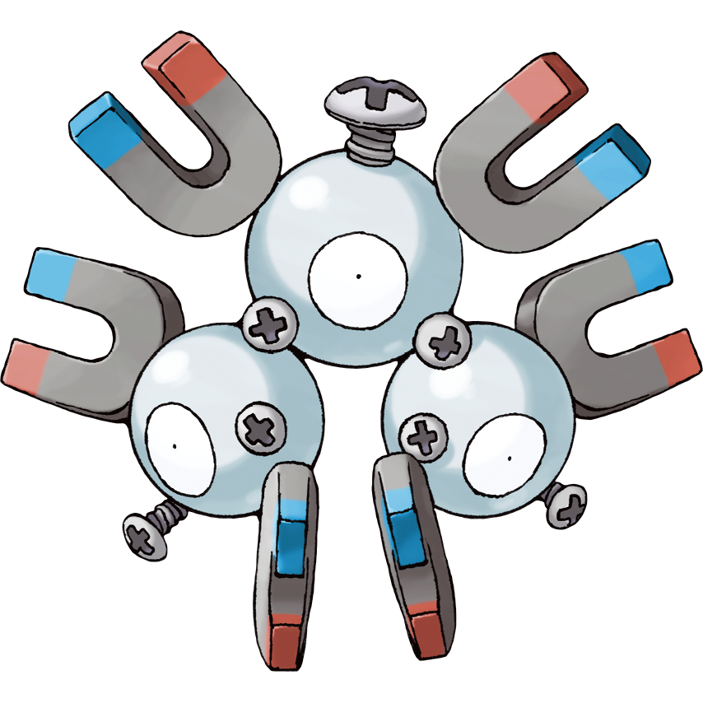
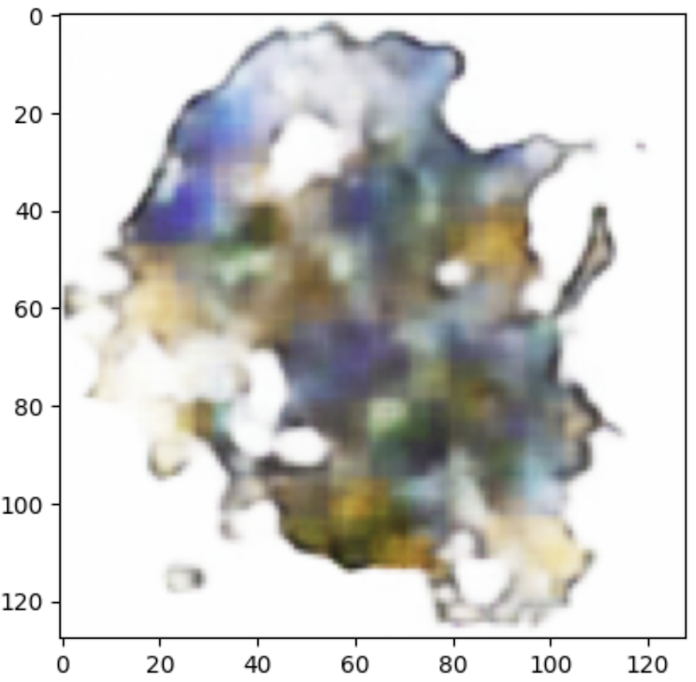


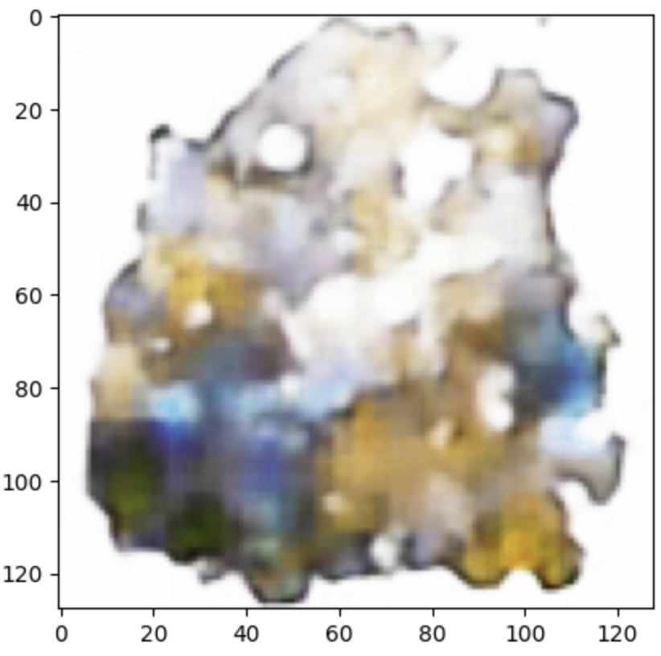
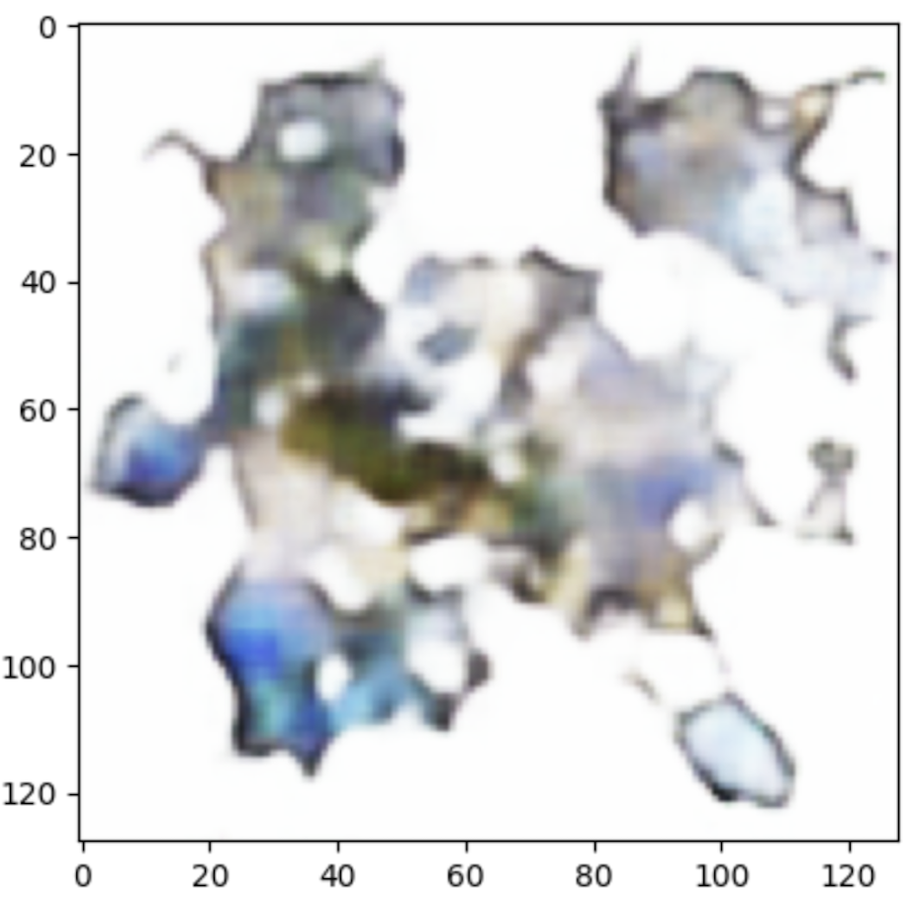
Challenge: The Result Makes No Sense!

Slide 8
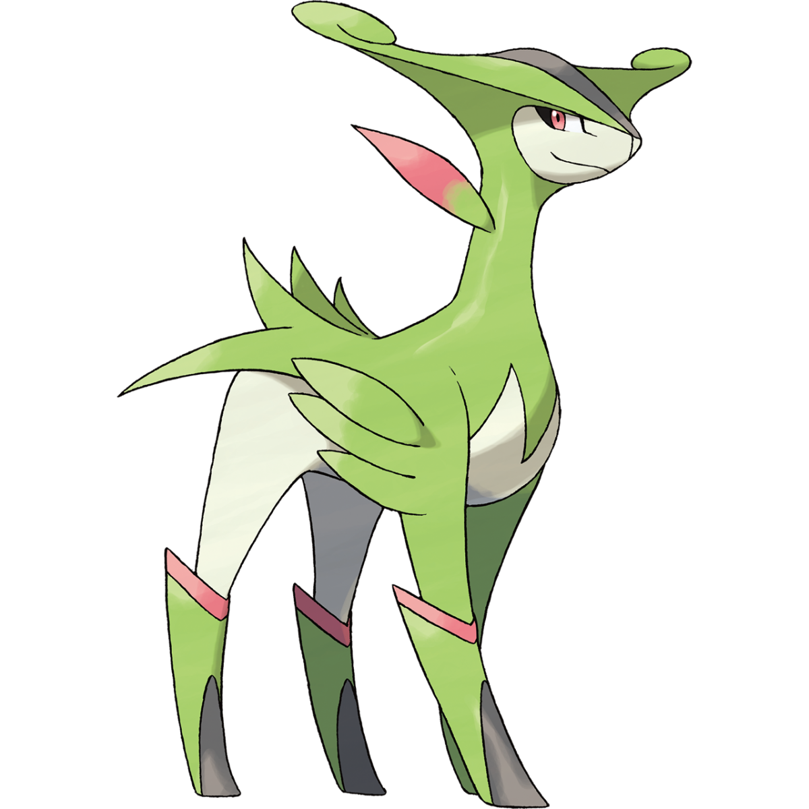






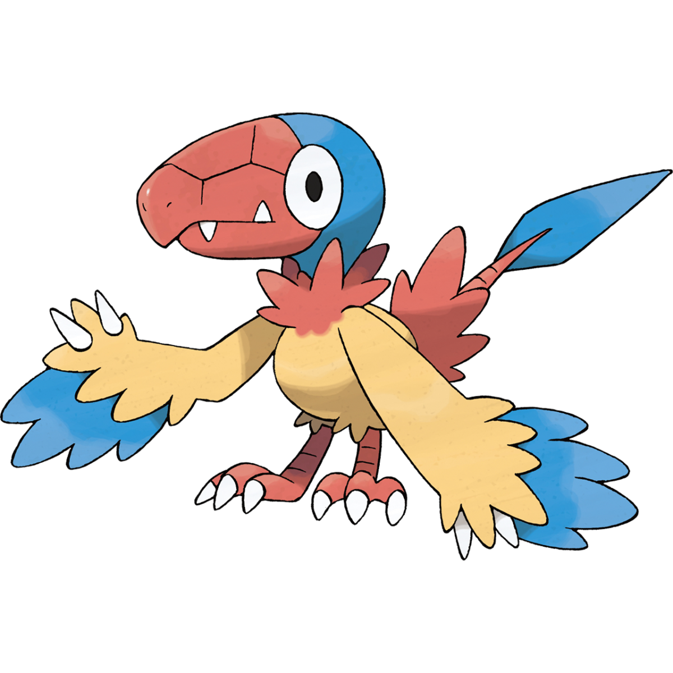





Challenge Solution: New Datasets!
Pokedex
Pokemon mystery dungeon

Slide 9

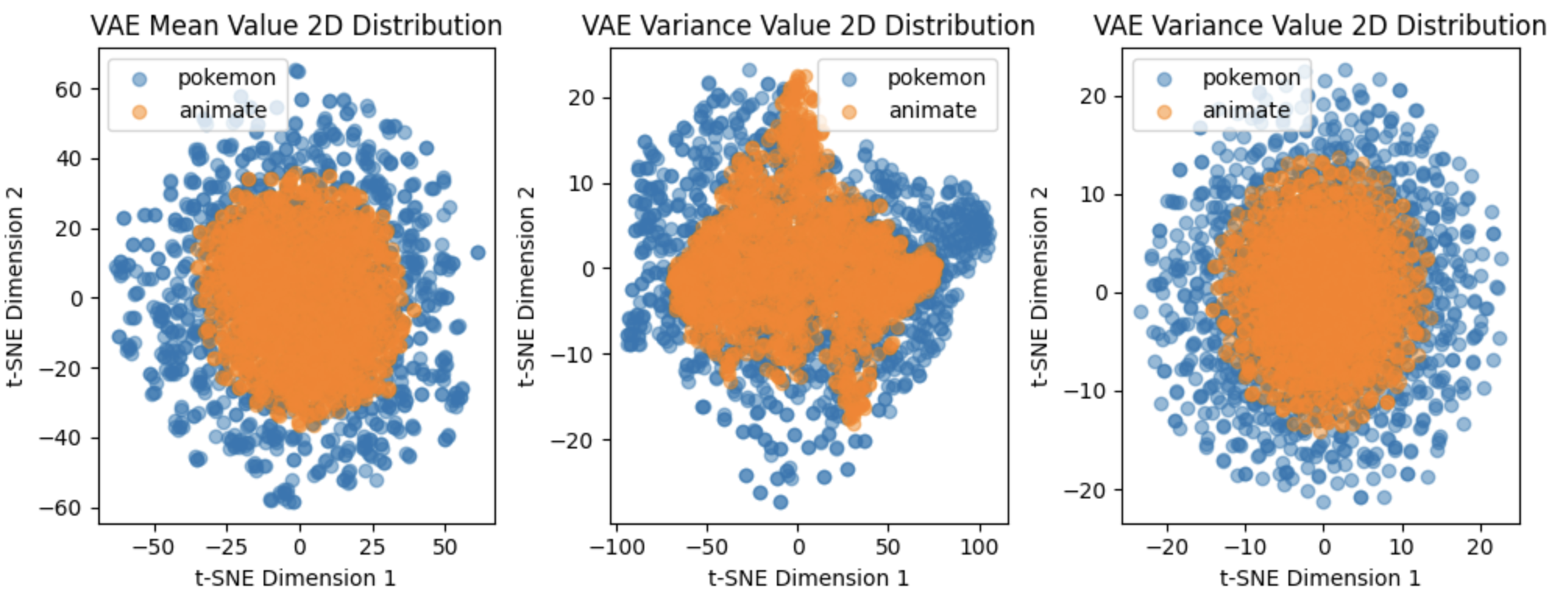
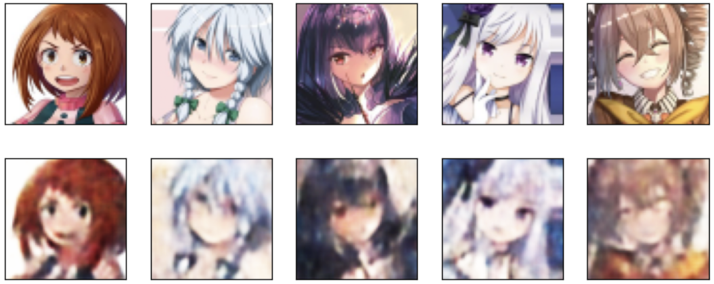
Results & Conclusion - VAE

Slide 10
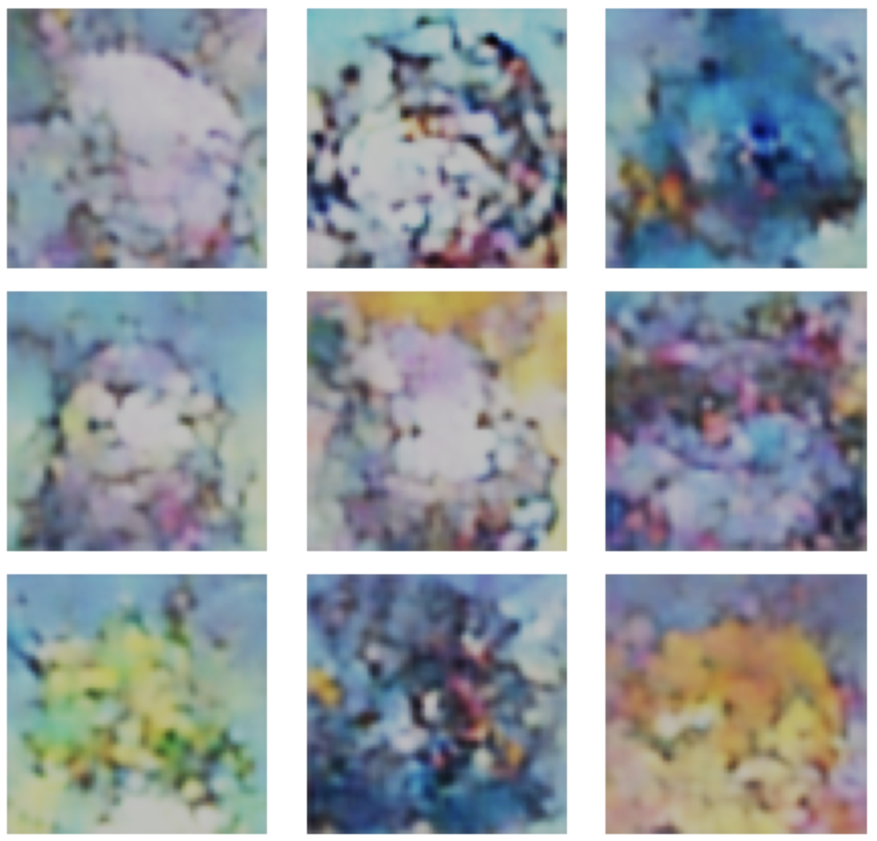

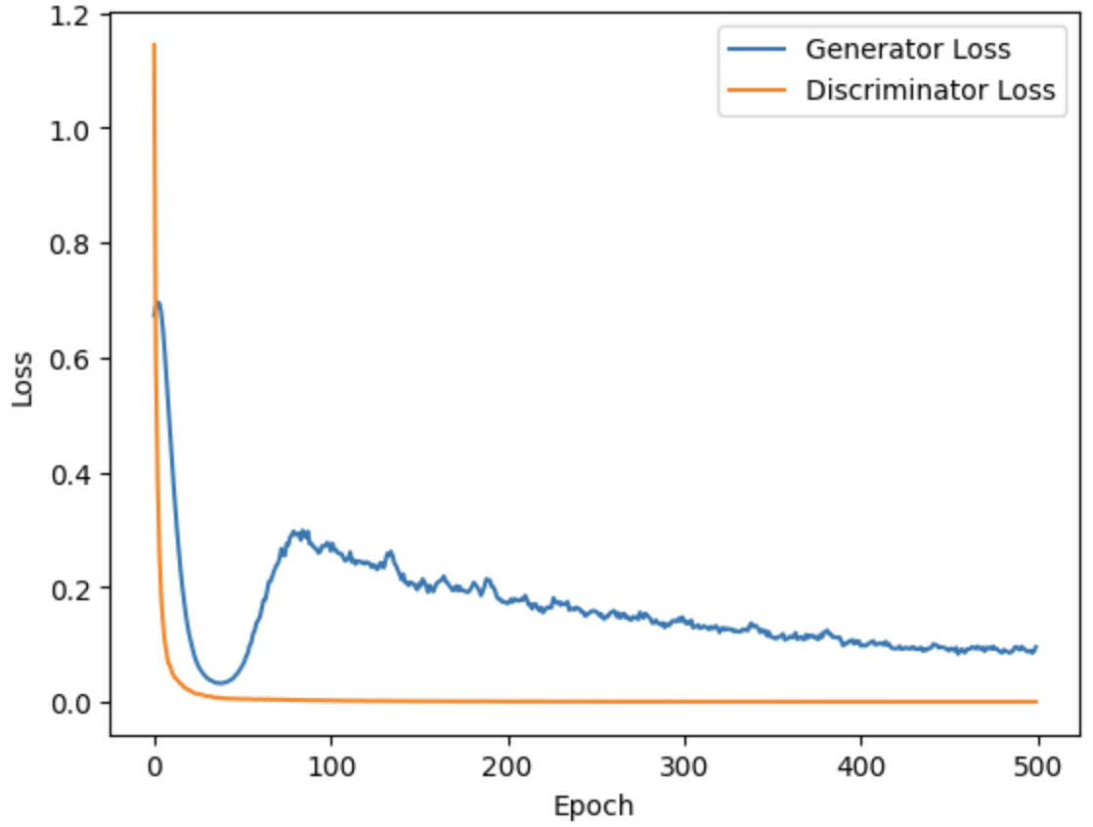
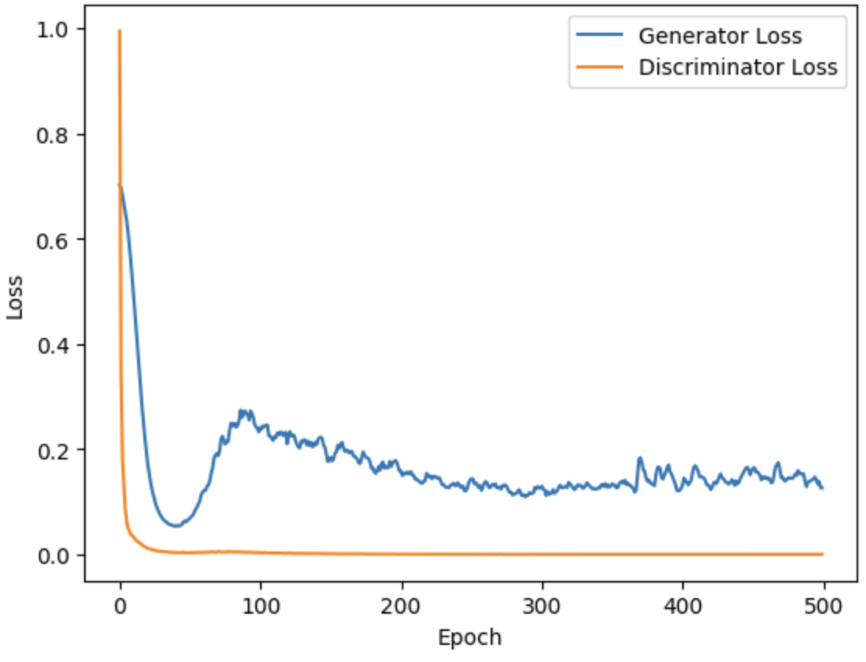
Results & Conclusion - GANs

Slide 11
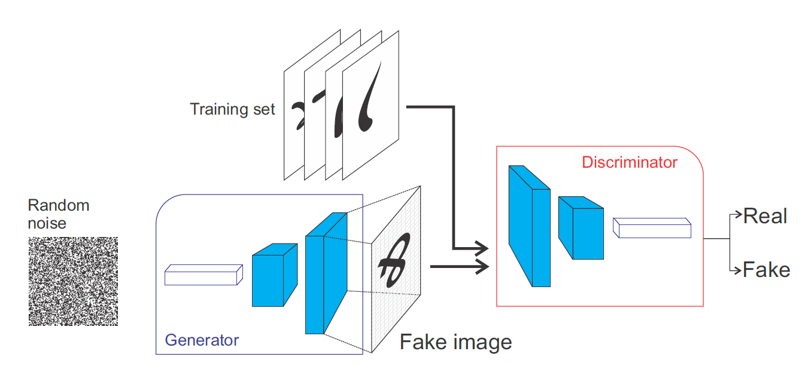

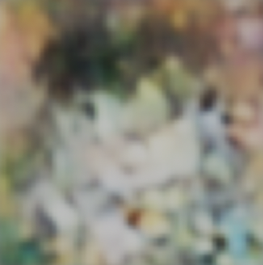


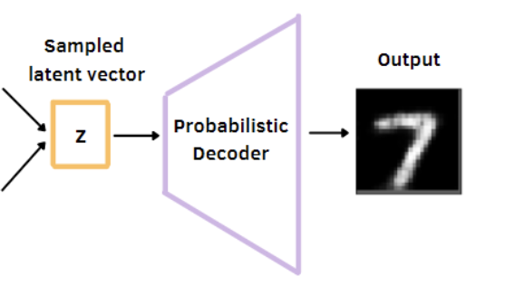

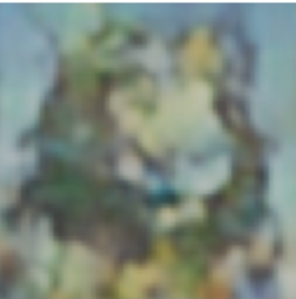



Results & Conclusion from Further Investigation - GANs
？

Slide 12
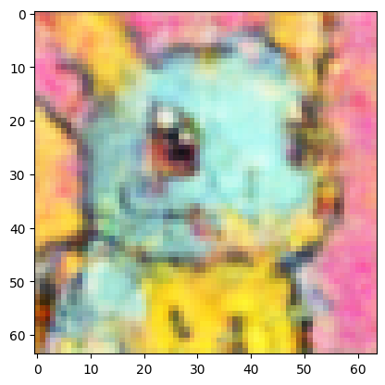
Fun Fact: We Can Do This By Just VAE!

